Slide 1

Growing in Faith: LD 25-31
Holy Baptism – For Children Too
Lesson 03 – LD 27b

Slide 2
Ps 105:3
He is the Lord, our God unfailing,
his judgments everywhere prevailing.
He will remember and uphold
his cov’nant made in days of old.
The steadfast words of his command
a thousand generations stand.

Slide 3
Baptism
He who believes and is baptized will be saved
Mark 16:16
preaching
faith
baptism
But for children it is:
baptism
preaching
faith
Is it Biblical to baptize children?

Slide 4
In favour or against?

This was already an issue when the Catechism was written.
- Roman Catholics, Lutherans and Calvinists would baptize children.
- Anabaptists (Mennonites) would not.
baptism
preaching
faith
Is it Biblical to baptize children?

Slide 5

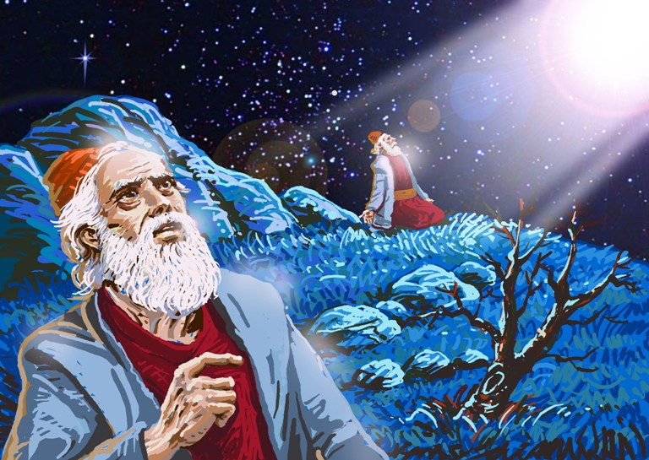
Bible Study: Genesis 17:9-14

Slide 6
Bible Study: Genesis 17:9-14
1. Every male
2. A sign of the covenant
3. Eight days old
4. Everyone in the family
5. Children could belong to God’s covenant in the OT

Slide 7
Baptism and circumcision

Old Testament: circumcision is the sign and seal of belonging to God
New Testament: baptism is the sign and seal of belonging to God
New Testament: circumcision is no longer required
Therefore: baptism has replaced circumcision.
Old Testament: Infants were to be circumcised
Therefore: Infants can be baptized in the New Testament

Slide 8
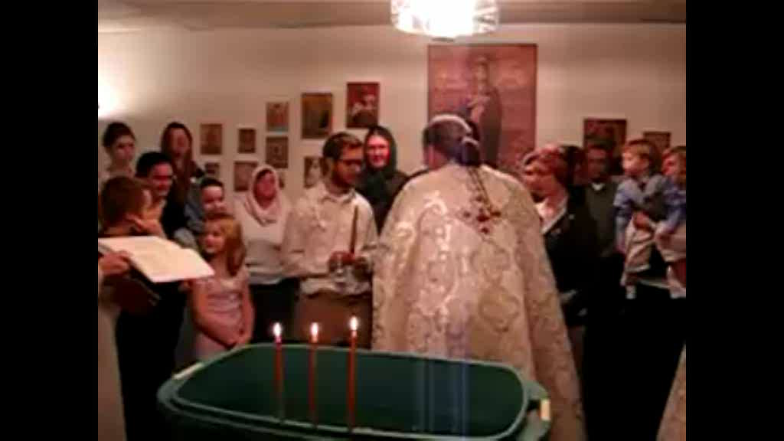
Infant baptism – Orthodox Church

Slide 9

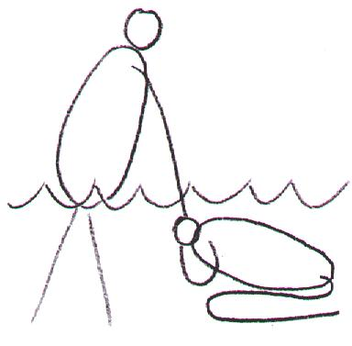
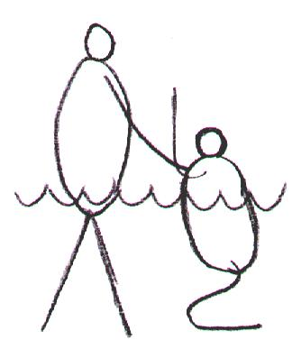
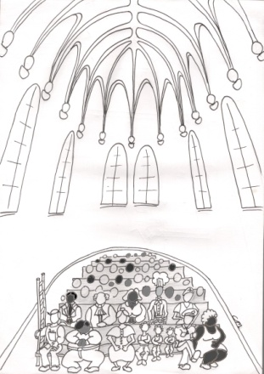
The following applies to children too!
Being washed of your sins
Dying and coming to life
Being incorporated

Slide 10
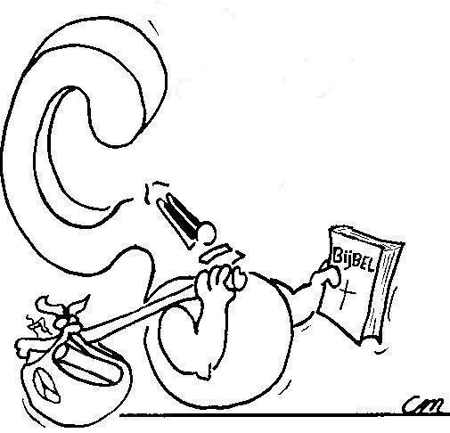
But what about these texts?

He who believes and is baptized will be saved
Mark 16:16
What does this text say with respect to baptism of children?
A. Mark 16:16 does not say “first believe and then baptize”
B. Mark 16:16 sets the standard for the mission situation (it relates to adults)

Slide 11
But what about these texts?

For the unbelieving husband has been sanctified through his wife, and the unbelieving wife has been sanctified through her believing husband. Otherwise your children would be unclean, but as it is, they are holy.
1Corinthians 7:14
What does this text say with respect to baptism of children?
C. 1 Cor 7:14 indicates that even children who have two living parents of whom only one is a believer are to be considered holy (=belong to God’s covenant)

Slide 12
But what about these texts?

I also baptized the household of Stephanas
1Corinthians 1:16
What does this text say with respect to baptism of children?
D. The so-called household texts prove little. While the texts favour infant baptism, one cannot say with 100% certainty that these households included children.

Slide 13

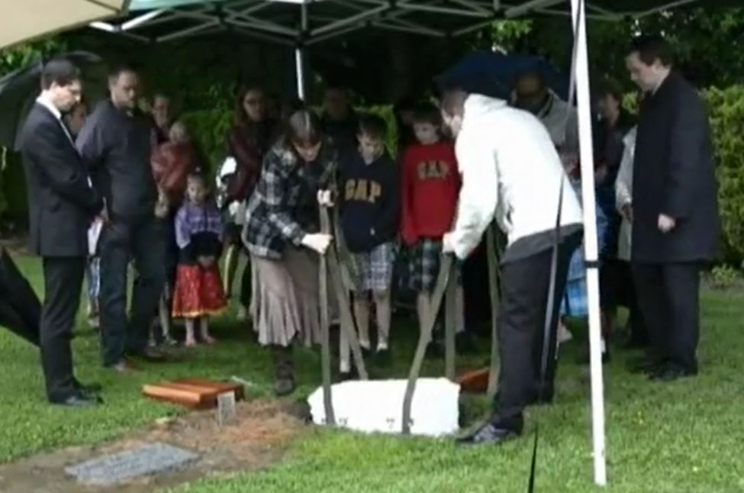
Canons of Dort I.17

Slide 14
Canons of Dort I.17
1. Not by nature
2. By virtue of the covenant of grace
3. Not doubt the election and salvation of their children who die in infancy

Slide 15
Children dying in infancy

baptism
preaching
faith
What if a baptized person dies before believing and professing their faith? Are they saved or not?
a matter of God’s grace & judgment
depends on their ability to believe
depends on their attitude to faith

Slide 16
Baptism and Faith
Baptism is a sign and seal of God’s promise (covenant).
Faith describes what people do with God’s promise.
Those who are able to believe and do so:
Those who are not yet able to believe:
preaching
faith
baptism
baptism
preaching
faith

Slide 17
Baptism and Faith
Baptism is a sign and seal of God’s promise (covenant).
Faith describes what people do with God’s promise.
Those not baptized who can believe but refuse:
Those baptized young who later refuse to believe:
preaching
faith
baptism
preaching
faith

Slide 18
Baptized unbelievers

Does it make a difference to God whether an unbeliever is baptized or not?
Yes. A baptized unbeliever is worse off in the final judgment than an unbeliever who has not been baptized.
"That servant who knows his master's will and does not get ready or does not do what his master wants will be beaten with many blows. But the one who does not know and does things deserving punishment will be beaten with few blows. From everyone who has been given much, much will be demanded; and from the one who has been entrusted with much, much more will be asked.”
Luke 12:47-48

Slide 19
Children of unbelievers
There is one clear example in the Bible of the child of unbelieving parents being saved. However, this child was a covenant child. 1 Kings 14:13: the son of Jeroboam I.
As to children outside the covenant, Scripture is silent.
Thus we should leave this matter in the hands of a good and righteous God.
“For what have I to do with judging outsiders?”
1Corinthians 5:12

Slide 20



Christians who believe children are allowed to be baptized.
What are
paedo-baptists?

