Slide 1
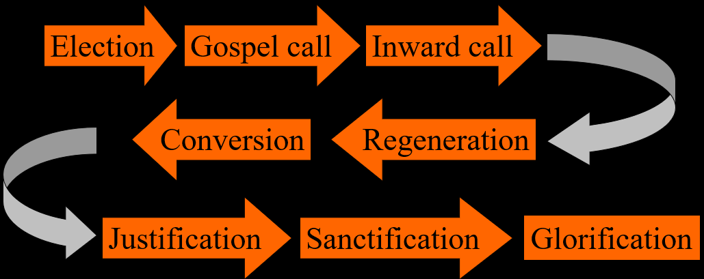
The Order of Salvation
General Introduction
Lesson 01

Slide 2
Hymn 64:1,2
What is in life and death my only aid,
my comfort when I am by troubles swayed?
I am not mine but Christ’s, who fully paid
for all my sins and saved me.
His precious blood for my offences gave he,
freed me from all the devil’s power and slavery,
for in the book of life God did engrave me,
and me his own he made.

Slide 3
Hymn 64:1,2
My faithful Saviour keeps me in his care;
without my Father’s will cannot a hair
fall from my head; he shall for me prepare
a heavenly habitation.
All things must serve to further my salvation.
His Holy Spirit brings me consolation;
he makes me willing now with dedication
in hope his yoke to bear.

Slide 4
Preliminaries
Less lecturing, more discussion
Worksheets: space for further notes
No separate course on Belgic Confession and Canons of Dort, but integrated into lesson material.
Homework and review, as you are accustomed.
www.whcanrc.com
Curriculum for this year:
  Order of Salvation
  Outreach
  Various individual topics
    If you have a request, that’s welcome!

Slide 5







Growing in (the) faith

Slide 6

Which came first?
Did you choose God or did God choose you?

Slide 7
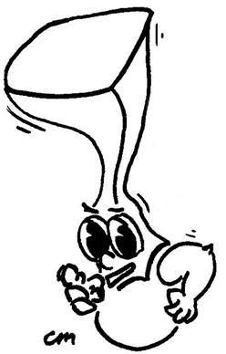
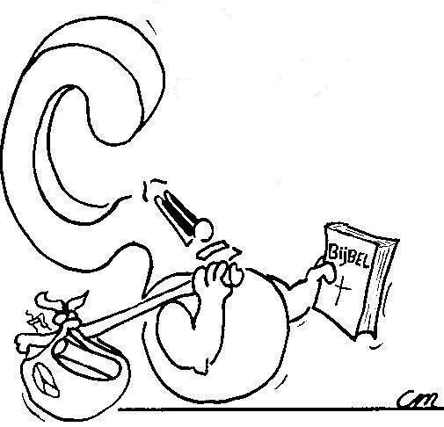
Soteriology
The study of salvation.
So Te what?

Slide 8
Soteriology
A big issue within Christianity is the question how people are saved.
Works or Grace?
If works, good deeds or the act of faith?
Is all faith “saving faith”?
First grace or first faith?
Much of this can be discussed in the context of the so-called ordo salutis, the Order of Salvation.

Slide 9
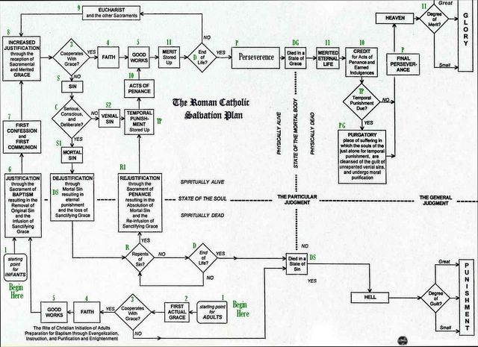

Slide 10

Golden Chain of Salvation
And those he predestined, he also called; those he called, he also justified; those he justified, he also glorified.
Romans 8:30
Election
Calling
Justification
Glorification

Slide 11
The chain expanded
Election
Calling
Justification
Glorification
Election
Gospel call
Inward call
Conversion
Regeneration
Justification
Sanctification
Glorification

Slide 12
Bible Study: 1 John 4:7-18
Although this passage does not describe the order of salvation, it does contain direct or indirect references to
all steps. Let’s read it together and figure it out.
Election
Gospel call
Inward call
God loved us
We … testify
He has given us of his Spirit
Conversion
Regeneration
Anyone acknowledges
Born of God
Confidence on the day of Judgment
Justification
Sanctification
Sacrifice for our sins
Love one another
Glorification

Slide 13

From two perspectives

Slide 14

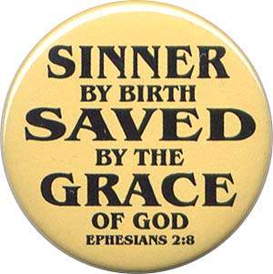


How?
God’s view
Man’s view

Slide 15

Discussion
What would be the difference between God’s view and man’s view?
Which steps would we understand best? Why?
Why don’t we understand much of other steps?
Election
Gospel call
Inward call
Conversion
Regeneration
Justification
Sanctification
Glorification

Slide 16

Order of Salvation - why bother?
1. Discusses fundamental issues in the experience of faith-life, making you “balanced” (neither unduly excited nor deeply depressed).
2. Grapples with issues that have our curiosity but are in part beyond our understanding (the Bible calls these “mysteries of the faith”)

Slide 17
Where are you at?
Where do you think you are in this chain of events?
Election
Gospel call
Inward call
Conversion
Regeneration
Justification
Sanctification
Glorification
Notes:
Note that the chain of events is not necessarily chronological.

