Slide 1
The Order of Salvation
Election – 1 (of 3)
Lesson 02

Slide 2
Psalm 65:2
When we are grieved by our transgressions
and overwhelmed by sins,
you blot them out in your compassion
and give us peace again.
How blest are those whom you have chosen,
whom you in love embrace;
within your courts, in you reposing,
they have a dwelling place.

Slide 3

Which came first?
Did you choose God or did God choose you?

Slide 4
The chain of salvation
Election
Gospel call
Inward call
Conversion
Regeneration
Justification
Sanctification
Glorification

Slide 5


Bible Study: Ephesians 1:3-11

Slide 6
Bible Study: Ephesians 1:3-11
1. Because God has blessed us with every spiritual blessing in the heavenly places
2. God chose us
3. For adoption as sons
4. The purpose of His will
5. To the praise of His glorious grace
6. Jesus Christ
7. Redemption through His blood, the forgiveness of trespasses
8. According to the counsel of His will

Slide 7
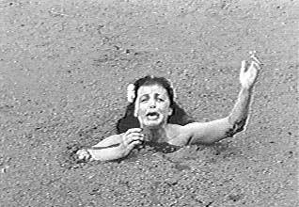

All are in the quicksand of sin
Everybody is conceived and born in sin; everybody is sinful.
This is not God’s fault but our own fault.
Therefore, just as sin came into the world through one man, and death through sin, and so death spread to all men because all sinned
Romans 5:12

Slide 8
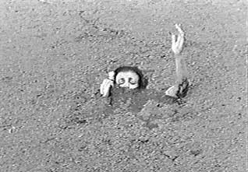
God could have left us there
It would have been fair of God if He had left all of us in the quicksand of sin
For the wages of sin is death...
Romans 6:23a

Slide 9
God wanted to save some
God does not want all to perish.
In His love He choses to save some.
Those whom God has chosen to save are called “the elect.”
Those whom God does not save are called “the reprobate.”
...as many as were appointed for eternal life believed.
Acts 13:48b
They stumble because they disobey the word, as they were destined to do.
1 Peter 2:8b

Slide 10
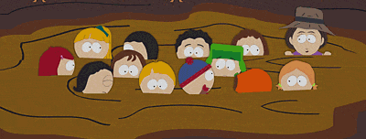
Election and Reprobation
Election: God choses (elects) certain people to be saved from eternal destruction
Reprobation: God leaves certain people in the mess into which they brought themselves

Slide 11
When and how did God choose?
God chose us before we existed as persons
God chose us “in Christ”
- He did not choose us as individuals
- He chose us in a relationship to the Son of God
(like choosing people because they are members of a family)
For God chose us in Christ before the foundation of the world…
Ephesians 1:4a

Slide 12

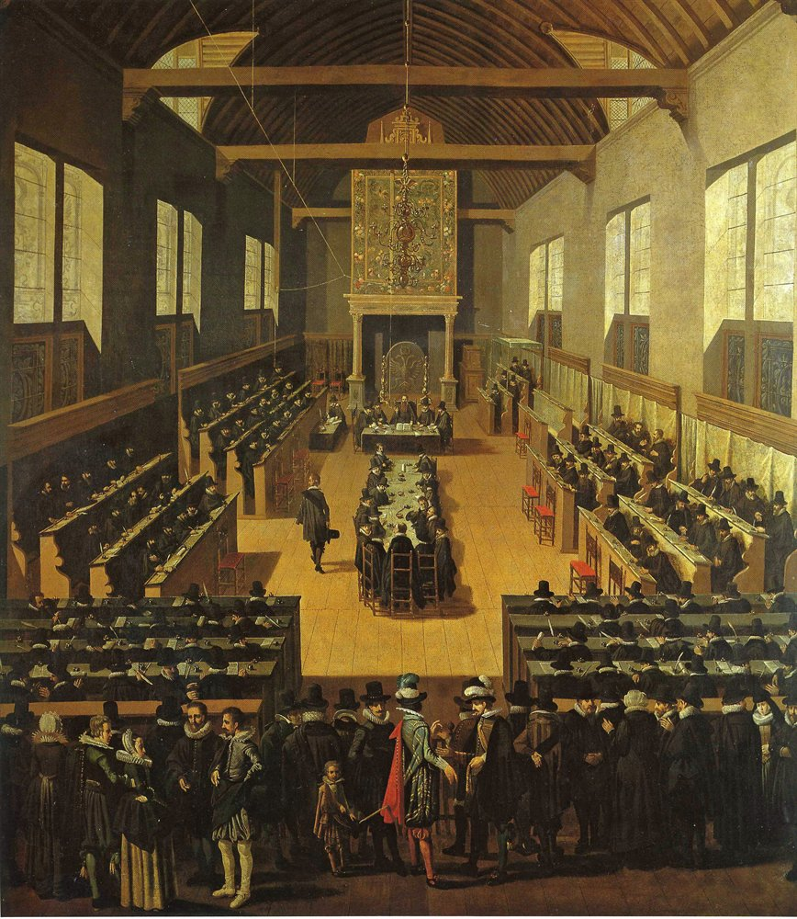
Canons of Dort I.1-7

Slide 13
Canons of Dort I.1-7
1. No
2. In the sending of His only-begotten Son into the world
3. To whom He wills and when He wills
4. Those who do not believe remain under God’s wrath
Those who do believe receive eternal life
5. With man
6. With God
7. Because of His eternal decree.
8. All men are equally worthy of condemnation

Slide 14
Canons of Dort I.1-7
9. It provides unspeakable comfort
10. A definite number
11. Mediator and Head of all the elect
12. God’s mercy
13. The riches of God´s glorious grace
14. About God

