Slide 1
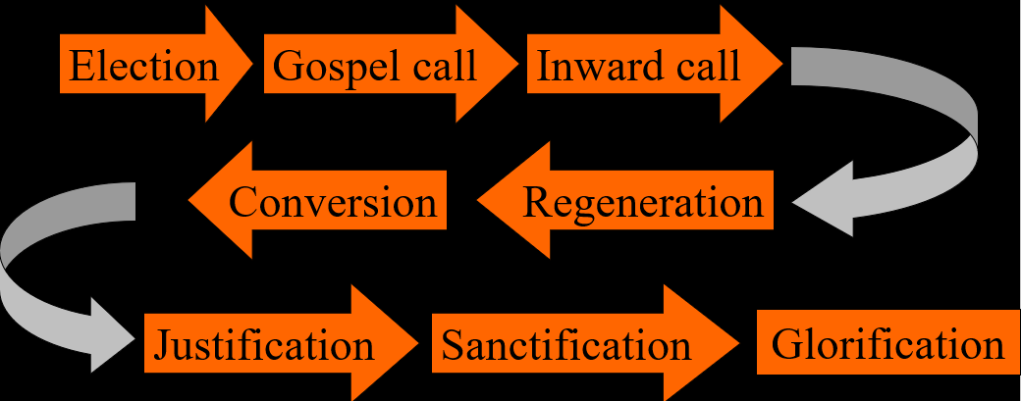
The Order of Salvation
Election – 2 (of 3)
Lesson 03

Slide 2
Psalm 16:3
You will maintain my happy lot, O Lord;
the lines have fallen in most pleasant places.
The heritage that You to me award
is my delight, a gift that I hold precious.
Your meas’ring-rod has blessed me with Your favour,
marked out a place to be enjoyed forever.

Slide 3
The chain of salvation
Election
Gospel call
Inward call
Conversion
Regeneration
Justification
Sanctification
Glorification
A logical but NOT a chronological order

Slide 4

Canons of Dort I.1-7
1. No
2. In the sending of His only-begotten Son into the world
3. To whom He wills and when He wills
4. Those who do not believe remain under God’s wrath
Those who do believe receive eternal life
5. With man
6. With God
7. Because of His eternal decree.
8. All men are equally worthy of condemnation

Slide 5
Canons of Dort I.1-7
9. It provides unspeakable comfort
10. A definite number
11. Mediator and Head of all the elect
12. God’s mercy
13. The riches of God´s glorious grace
14. About God

Slide 6

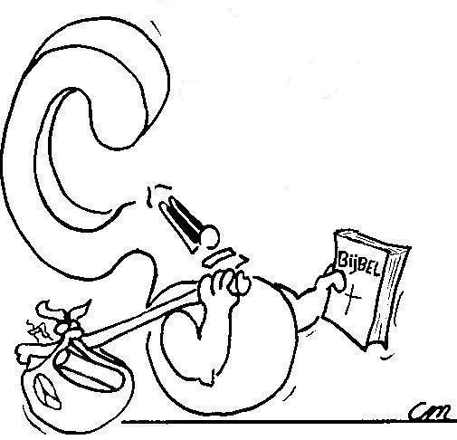
God chooses according to the purpose of His will, according to His good pleasure
Why does God choose some people and not others?

Slide 7
God did not choose certain people because

they are better, more perfect than others
As it is written: “There is no one righteous, not even one; … All have turned away, they have together become worthless; there is no one who does good, not even one.”
Romans 3:10,12
[The elect are] neither better nor more worthy than others, but involved together with them in a common misery
Canons of Dort I.7

Slide 8
God did not choose certain people because

they believe in God while others don’t
- God does not wait with choosing until you believe
- God does not choose on the basis of His knowledge that you are going to believe
For it is by grace you have been saved, through faith—and this not from yourselves, it is the gift of God—
Ephesians 2:8
This election is not based on foreseen faith, the obedience of faith, holiness, or any other good quality of disposition...
Canons of Dort I.9

Slide 9
God chooses

NOT on account of the quality of your works
NOR on account of the quality of your faith
BUT on account of His good pleasure and will
God chooses those He loves
God loves whomever He wants
The LORD did not set his affection on you and choose you because you were more numerous than other peoples, for you were the fewest of all peoples. But it was because the LORD loved you and kept the oath he swore to your forefathers
Deuteronomy 7:7-8

Slide 10
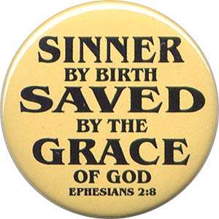

Election?
God’s view
Man’s view

Slide 11

The chosen

Election is a decree of God
- set before time began (God’s view)
- executed in the course of time (man’s view)
God’s choice becomes evident in man’s choice.
A person who chooses for God has already been chosen by God. For you can’t choose for God without God’s help (He gives faith)
A person who does not choose for God has not been chosen by God. For God rejects all who do not choose for Him.

Slide 12
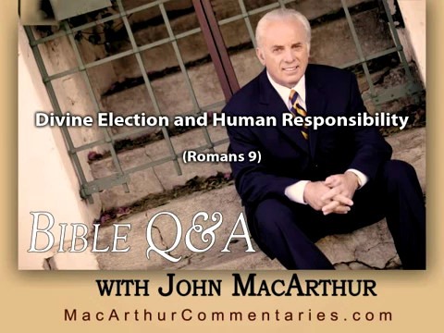
Notes:
2:00 minutes

Slide 13
Canons of Dort I.11-13
1. Because God is unchangeable, His decree stands
2. By inquisitively prying into the hidden and deep things of God
3. By observing the unfailing fruits of election
4. No because it humbles them before God, they praise God, and seek forgiveness and renewal to serve God

