Slide 1
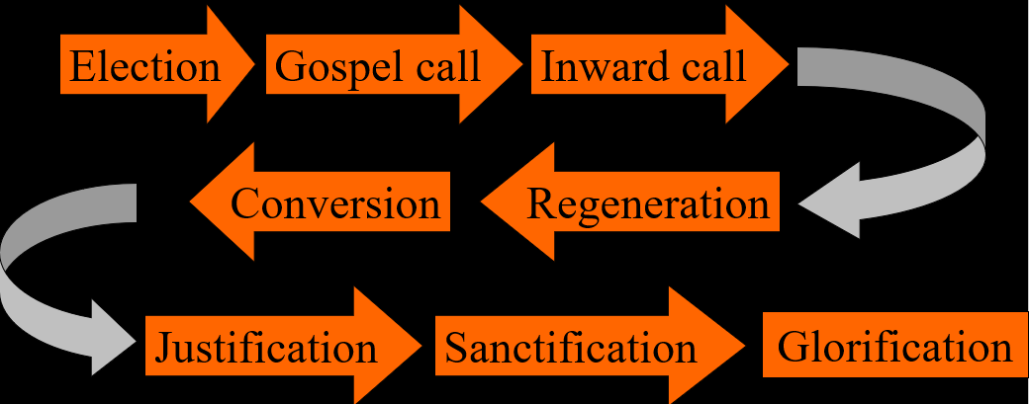
The Order of Salvation
Election – 3 (of 3)
Lesson 04

Slide 2
Psalm 138:4
LORD, you will to my rescue come
when troubles loom from all directions.
Though enemies around me swarm,
your mighty arm is my protection.
God shall fulfil his plan for me;
his promise he will keep forever.
LORD, God of grace, do not cast off
your works of love. Forsake them never!
Notes:
Alternative: Romans Doxology (if the class is larger)

Slide 3
The chain of salvation
Election
Gospel call
Inward call
Conversion
Regeneration
Justification
Sanctification
Glorification

Slide 4

What election can do
It can make a person believe unto heaven but live unto hell. For, whether I go to heaven depends on God’s choice, not mine.
Approach one: I might as well live in sin until I know I'm elect.
(The Netherlands Reformed approach?)
Approach two: I'm elect anyway, whether I live in sin won’t change God’s decree.
(The Canadian Reformed approach?)

Slide 5

Canons of Dort I.14-16, 18
1. Yes (so should we add it to the Catechism?)
2. Neither.
3. No (we’ll look at this further in a moment)
4. No
5. No
6. Yes
7. Who are we to answer back to God?
8. One of reverent adoration

Slide 6
Am I a chosen one?
A person who chooses for God has already been chosen by God.
If you’re convinced you’ve chosen for God, you can be confident God has already chosen you!
In this is love, not that we have loved God but that he loved us and sent his Son to be the propitiation for our sins.
We love because He first loved us.
1 John 4:10 & 19

Slide 7
On someone else’s election...
Can a person say of someone else: (s)he’s saved?
The Canadian Reformed tend to say in obituaries that someone has gone to be with the Lord. How can you know that? May we say that?
The Netherlands Reformed will go no further than say that someone has passed away “in the hope of eternal life” (see Titus 3:7).

Slide 8
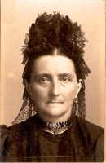
Surprise!
Notes:
My backdoor neighbour in my last congregation in The Netherlands was an old lady who belonged to a Netherlands Reformed Congregation. She was a most godly woman, but totally unsure of her election, thus not convinced she was saved. Her daughter was a member of my church. One day her daughter was at my door: “Mom passed away last night.” “My condolences,” I said, “won’t she have been surprised.” The daughter looked at me rather puzzled. “She may not have been convinced of her salvation,” I continued, “but you and I are, knowing how godly she was. And now she knows too.” At which the daughter broke out in a smile and nodded. (I was then asked to lead the funeral as her church had no minister; but that was very quickly blocked by her church’s consistory.)

Slide 9
Hypocrites
Hypocrites will pretend to be elect while they know for themselves they are not. Hypocrites are never bothered by the question of their election.
Which means: if you are bothered by the question of your election, you are not a hypocrite!
Believers can be bothered by the question of their election. The problem here is not whether they are elect, but whether they know they are elect. Being unsure of your election does not annul your election.

Slide 10
CoD I.16
Not yet a living faith but desire it
  People of “little faith”
Not yet the maturity in faith they desire
  The “weak in faith”
Those who disregard God
  A “dead” faith, unbelievers
Those who serve God with mind, heart, and body
  Strong in faith, great faith, believers

Slide 11

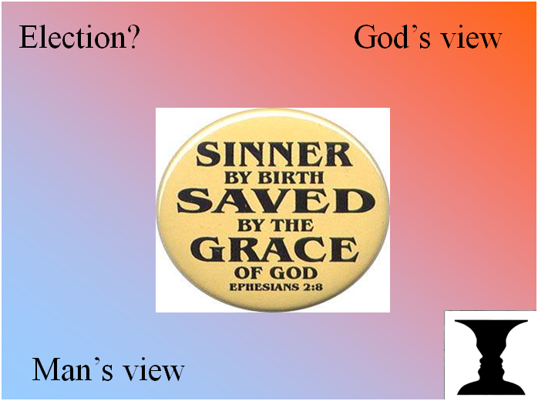
Two perspectives

Man God
I choose for God God chooses me
During the course of my life Before the world began
It begins with believing It begins with election
or baptism

Slide 12
Mysteries of the faith

In the Bible, the word ‘mystery’ is used to indicate something that can be told and known, but cannot be explained and understood.
Mysteries of the faith include:
  The Trinity: how can God be three in one?
  Creation: how did God make everything?
  The natures of Christ: how can Jesus be both God and man?
  The origin of evil: if God created all things good, where does evil come from?
  God and man: if God is control of everything, how can man be held responsible for his actions?

Slide 13
Election is a mystery

We know at bottom, God chooses us.
God makes His choice known by having us choose for Him.
God making us choose Him is a matter of grace.
We cannot understand this, it is a mystery to us how this can be.
We, however, with reverent adoration of these mysteries...
Canons of Dort I.18

Slide 14

The chain of salvation
Election
Gospel call
Inward call
Conversion
Regeneration
Justification
Sanctification
Glorification

Slide 15
The comfort of election

If you have a crush on someone, (s)he may not have a crush on you.
But: if you choose for God, you may know for sure God has chosen you!
If you love God, rest assured, God loves you!
If you do not love God, beware, God is mad at you!

