Slide 1
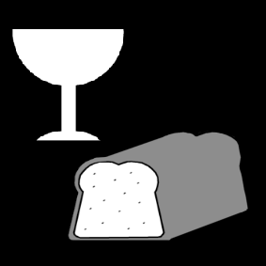
Growing in Faith: LD 25-31
Lord’s Supper – Who May Come?
Lesson 05 – LD 30

Slide 2
Hymn 59:2
Come, let us then with contrite hearts draw near
to seek the pledges of his mercy here.
He who his saints in this world rules and shields
to all believers life eternal yields,
with heav’nly bread makes those who hunger whole,
gives living waters to the thirsty soul.
Let us his holy supper celebrate
and, so refreshed, our coming King await.

Slide 3
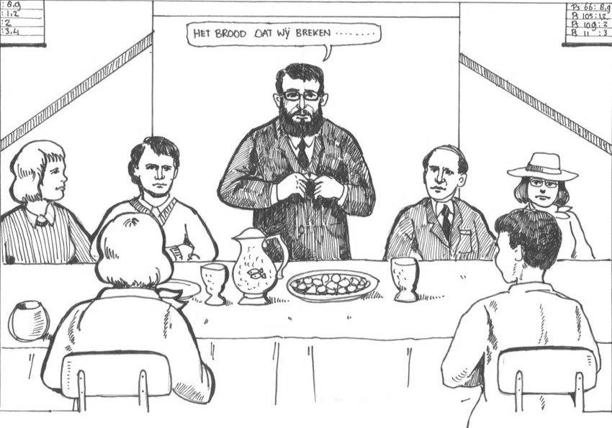
Who may come?
The bread which we break…

Slide 4
Often skips church
Stern elder
Bully
The bread which we break…
Gossip
Spend thrift
Underage drinker
Proud minister

Slide 5

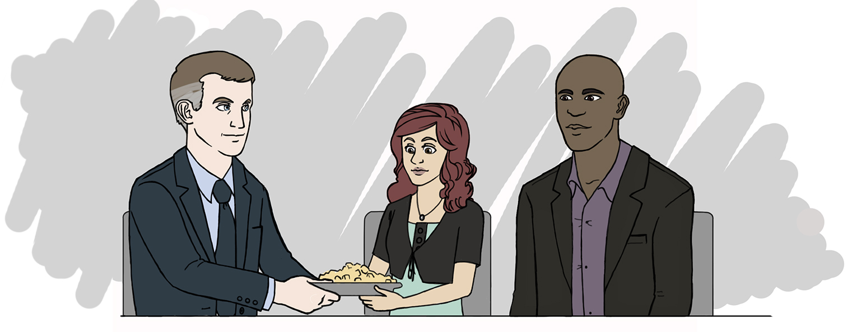
Bible Study: 1 Cor 11:23-29

Slide 6
Bible Study: 1 Cor 11:23-29
1. From the Lord (Jesus Christ)
2. The death of the Lord
3. Anyone who eats and drinks in an unworthy manner
4. Examine yourself
5. Eat and drink judgement on yourself

Slide 7
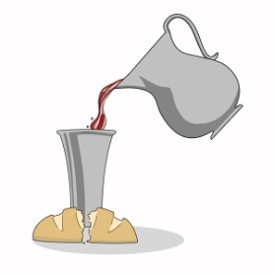
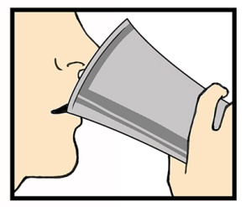

Who may come?
Those to whom this applies
Forgiven
Renewed
Part of the Church

Slide 8
What is not necessary

A perfect life without sin (no one is perfect)
A certain level of goodness (the point is faith)
An unwavering faith (no one believes for 100%)
What is necessary
Heartfelt sorrow over sins
The desire to live according to God’s commandments
Desire to fight against all unbelief and doubt
Trust (faith) in God’s promises of forgiveness and renewal

Slide 9
Who may not come?
Those to whom this does not apply
Forgiven
Renewed
Part of the Church

Slide 10
Who may not come?

Those who live in sin and refuse to repent
Those to whom this does not apply
Forgiven
Renewed
Those who have a different faith
Part of the Church

Slide 11

Who may come and who not?
Class discussion – sin against the 6th commandment
Where would you draw the line when it comes to allowing someone to participate in the Lord’s Supper?
Someone who dislikes someone else
Someone who hates someone else
Someone who bullies someone else
Someone who hurts someone else
Someone who disables someone else for life
Someone who murders someone else

Slide 12
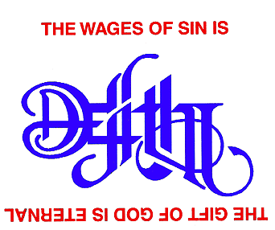
The criterion for coming

The point is not how sinful you are, how many sins you commit. You receive forgiveness, even if you’ve sinned 70 x 7 times!
The point is, what is your attitude to the sin in your life. Do you hate your sins or do you cherish them?

Slide 13
Who may come and who not?
Class discussion – sin against the 6th commandment
Where would you draw the line when it comes to allowing someone to participate in the Lord’s Supper?
Someone who dislikes someone else
Someone who hates someone else
Someone who bullies someone else
Someone who hurts someone else
Someone who disables someone else for life
Someone who murders someone else

Slide 14
Who may come and who not?
Class discussion:
Where would you draw the line when it comes to allowing someone to participate in the Lord’s Supper?
Those who repent of their sins
Those who do not repent of their sins.

Slide 15
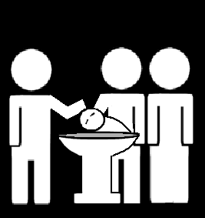
Sacraments and the covenant
Baptism is about the entry into the covenant
  Baptism is only about God’s promise to us
  In baptism we only receive
Lord’s Supper is about continuation in the covenant
  Lord’s Supper is about God’s promise to us and our promise to God; thus we receive and give
  Scripture explicitly requires self-examination before participating (1Cor 11:28-29); the ability to examine oneself is thus a requirement


Slide 16
Who may come and who not?
A Canadian Reformed church member
A United Reformed church member
A Christian Reformed church member
A Reformed Baptist
A Pentecostal (Arminian Baptist)
A Roman Catholic
A Jehovah’s Witness
A Mormon
A Sikh
An atheist (someone who believes God does not exist)

Slide 17

You may come

if your
is right before God
heart
Draw this on your worksheet too!

Slide 18
Lord’s Supper Form
Read together the invitation and admonition section of the Form for the Celebration of the Lord’s Supper (BoP pp. 603-604).
Discover and discuss how this section focuses not just on actions but goes deeper to the heart.
Question: the sinners mentioned parallel the first nine commandments. Why would the tenth not have been listed?
(time permitting)
Notes:
The tenth is not listed because it concerns the heart alone, and only God can judge the heart. Interestingly, in the Mosaic Laws, the death penalty was required for the most extreme form of sin against the first nine commandments, not the tenth. In the new covenant dispensation, that death penalty has been replaced with excommunication (being banned from the communion of saints, expressed at the Lord’s Supper).

