Slide 1


Growing in Faith: LD 25-31
The First Key of the Kingdom - Preaching
Lesson 6 – LD 31a

Slide 2
Hymn 81:1,2,5,6
1. O for a thousand tongues to sing
my great Redeemer’s praise,
the glories of my God and King,
the triumphs of his grace!
2. My gracious Master and my God,
assist me to proclaim,
to spread through all the earth abroad,
the honours of your name.

Slide 3
Hymn 81:1,2,5,6
5. He speaks, and, listening to his voice,
new life the dead receive;
the mournful broken hearts rejoice;
the humble poor believe.
6. Hear him, you deaf; you voiceless ones,
your loosened tongues employ;
you blind, behold your Saviour come;
and leap, you lame, for joy!

Slide 4

Keys prevent or grant access

Slide 5

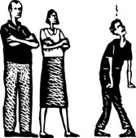
Keys to God’s Kingdom

Traditionally we speak of two keys to God’s Kingdom
the key of the Word
the key of Discipline

Slide 6
Tonight we look at
the key of the Word
How then will they call on him in whom they have not believed? And how are they to believe in him of whom they have never heard? And how are they to hear without someone preaching? Romans 10:14

Slide 7


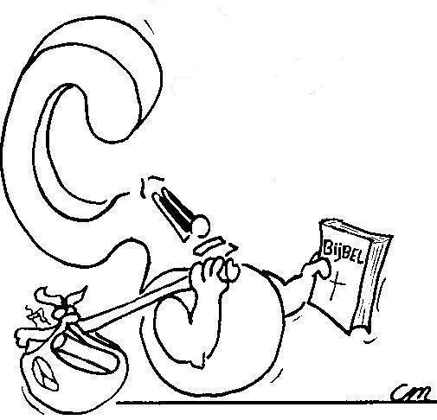
Preaching is telling people on behalf of God where things are at.
What is preaching?

Slide 8
Preaching is

Telling people
On behalf of God
Where things are at.
That message is, in brief:
- This world is God’s world and we are to serve God
- Those who don’t serve God will suffer God’s anger
- Those who do serve God will be saved from God’s anger
- In Christ, God gives us the means to salvation

Slide 9
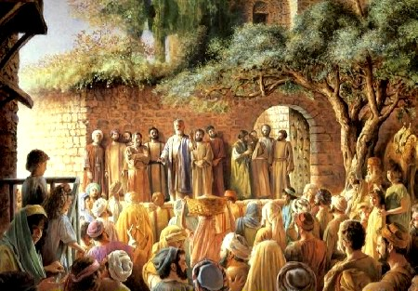
Bible Study: Acts 2:14-41

Slide 10
Bible Study: Acts 2:14-41
1. Peter and the Eleven
Peter
2. the Holy Spirit coming
3. Who Jesus Christ is, that he died but is now alive, and ruler of all creation
4. They were cut to the heart (distraught)
5. He called them to repentance
so as to receive the Holy Spirit.

Slide 11
Bible Study: Acts 2:14-41
6. Those who repent were saved: enter the Kingdom
Those who refused were not saved: the Kingdom stayed closed.
7. About 3000.

Slide 12
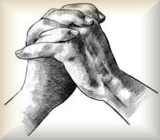

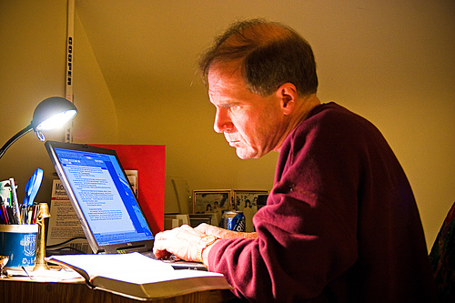
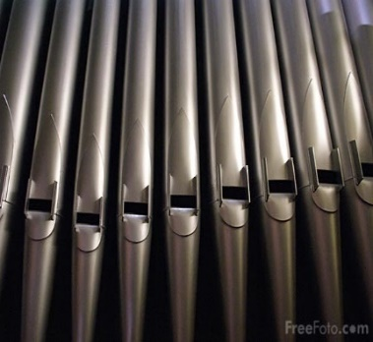
The making of a sermon

Prayer for enlightenment
Choose a text
Translate the text
Study the text (exegesis)
Consider what the text tells us
Write an outline
Liturgy (choose songs)
Prayer for creativity
Write the sermon & prayer of application
Review / Practice the sermon
Preach the sermon

Slide 13
Heidelberg Catechism
According to the command of Christ,
the kingdom of heaven is opened
when it is proclaimed and publicly testified
to each and every believer
that God has really forgiven all their sins
for the sake of Christ’s merits,
as often as they by true faith accept the promise of the gospel.
The kingdom of heaven is closed
when it is proclaimed and testified
to all unbelievers and hypocrites
that the wrath of God and eternal condemnation rest on them
as long as they do not repent.

Slide 14
Heidelberg Catechism
According to the command of Christ,
the kingdom of heaven is opened
when it is proclaimed and publicly testified
to each and every believer
that God has really forgiven all their sins
for the sake of Christ’s merits,
as often as they by true faith accept the promise of the gospel.
The kingdom of heaven is closed
when it is proclaimed and testified
to all unbelievers and hypocrites
that the wrath of God and eternal condemnation rest on them
as long as they do not repent.

Slide 15
Heidelberg Catechism
According to the command of Christ,
the kingdom of heaven is opened
when it is proclaimed and publicly testified
to each and every believer
that God has really forgiven all their sins
for the sake of Christ’s merits,
as often as they by true faith accept the promise of the gospel.
The kingdom of heaven is closed
when it is proclaimed and testified
to all unbelievers and hypocrites
that the wrath of God and eternal condemnation rest on them
as long as they do not repent.

Slide 16
Heidelberg Catechism
According to the command of Christ,
the kingdom of heaven is opened
when it is proclaimed and publicly testified
to each and every believer
that God has really forgiven all their sins
for the sake of Christ’s merits,
as often as they by true faith accept the promise of the gospel.
The kingdom of heaven is closed
when it is proclaimed and testified
to all unbelievers and hypocrites
that the wrath of God and eternal condemnation rest on them
as long as they do not repent.

Slide 17
Heidelberg Catechism
According to the command of Christ,
the kingdom of heaven is opened
when it is proclaimed and publicly testified
to each and every believer
that God has really forgiven all their sins
for the sake of Christ’s merits,
as often as they by true faith accept the promise of the gospel.
The kingdom of heaven is closed
when it is proclaimed and testified
to all unbelievers and hypocrites
that the wrath of God and eternal condemnation rest
on them
as long as they do not repent.

Slide 18
Heidelberg Catechism
According to the command of Christ,
the kingdom of heaven is opened
when it is proclaimed and publicly testified
to each and every believer
that God has really forgiven all their sins
for the sake of Christ’s merits,
as often as they by true faith accept the promise of
the gospel.
The kingdom of heaven is closed
when it is proclaimed and testified
to all unbelievers and hypocrites
that the wrath of God and eternal condemnation rest on them
as long as they do not repent.

Slide 19
What do you remember?
Write down what you remember of last
Sunday's morning sermon.
Do you recall
- hearing the promise of the gospel?
- being warned about God’s anger?
How? Write it down.
Then follows class discussion

