Slide 1
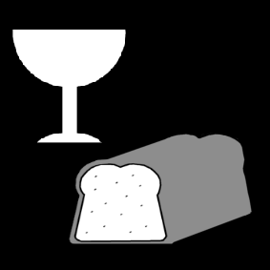
Growing in Faith: LD 25-31
Lord’s Supper – Who May Come?
Lesson 05 – LD 30

Slide 2
Hymn 59:2
Come, let us then with contrite hearts draw near
to seek the pledges of his mercy here.
He who his saints in this world rules and shields
to all believers life eternal yields,
with heav’nly bread makes those who hunger whole,
gives living waters to the thirsty soul.
Let us his holy supper celebrate
and, so refreshed, our coming King await.

Slide 3
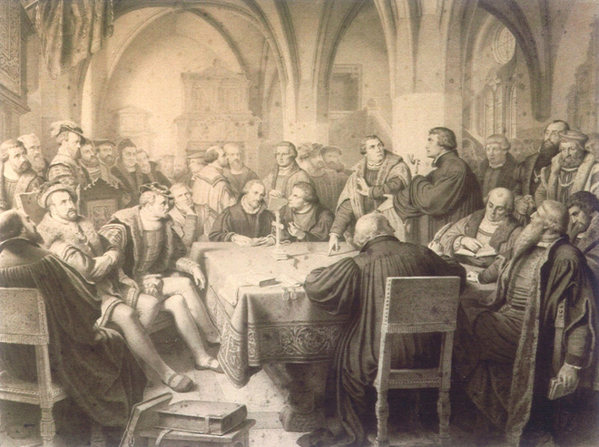
Marburg - 1529

Slide 4
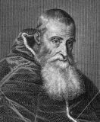
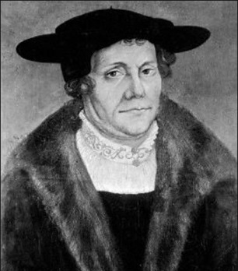
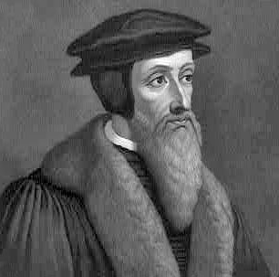
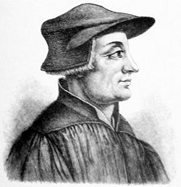
Different views

Roman Catholic: transubstantiation
  Bread and wine become body and blood of Christ
Lutheran: consubstantiation or impanation
  Christ is bodily present with or in the bread and wine
Calvinist: spiritual truth
  Bread and wine are symbols of a heavenly reality
Zwinglian: memorial truth
  Bread and wine are symbols of a past occurrence

Slide 5
Different views

Roman Catholic: transubstantiation
  Bread and wine become body and blood of Christ
  But grace is not effectively in the sacrament
Lutheran: consubstantiation
  Christ is bodily present in the bread and wine
  But Christ’s human nature is not divine!
Calvinist: spiritual truth
  Bread and wine are symbols of a heavenly reality
  Correct
Zwinglian: memorial truth
  Bread and wine are symbols of a past occurrence
  But the Lord’s Supper both signifies and seals

Slide 6
Different views

Roman Catholic: transubstantiation
  Bread and wine become body and blood of Christ
  But grace is not effectively in the sacrament
Lutheran: consubstantiation
  Christ is bodily present in the bread and wine
  But Christ’s human nature is not divine!
Calvinist: spiritual truth
  Bread and wine are symbols of a heavenly reality
  Correct
Zwinglian: memorial truth
  Bread and wine are symbols of a past occurrence
  But the Lord’s Supper both signifies and seals
Roman Catholic Church
(Conservative) Lutherans
(Conservative) Reformed
Many Evangelicals

Slide 7
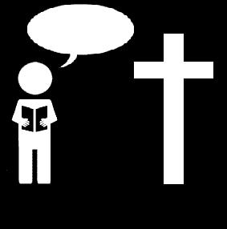
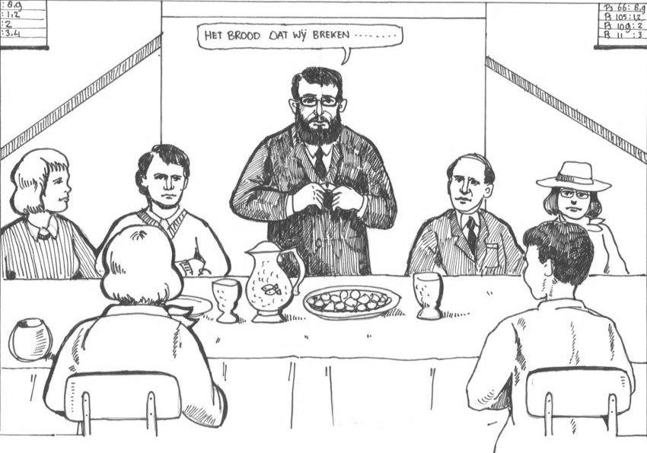
Church Study: LS Form
The bread which we break…

Slide 8
Church Study: LS Form
1. That we are perfect and righteous in ourselves
2. We are dead in ourselves
3. Our many sins and shortcomings
4. Our faith is imperfect
5. Our zeal is insufficient
6. Weakness of faith and evil desires of our flesh
7. Heartily sorry
8. Therefore we may be fully assured that no sin or weakness which still remains in us against our will can prevent us from being received by God in grace and from being made worthy partakers of this heavenly food and drink.

Slide 9
Who may come?
The bread which we break…
Notes:
Click to transition to next slide

Slide 10
Often skips church
Tax-cheat
Stern elder
The bread which we break…
Gossip
Spend thrift
Porn addiction
Proud minister

Slide 11
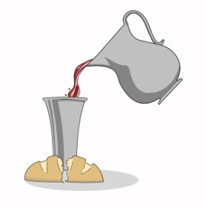
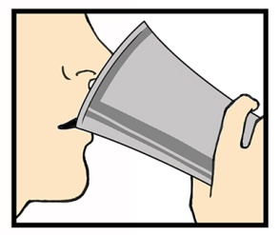
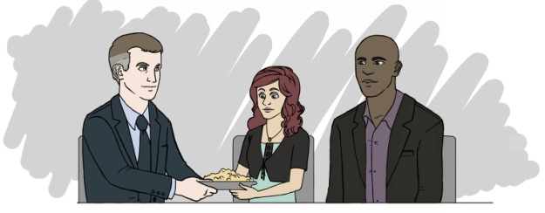
Who may come?
Those to whom this applies
Forgiven
Renewed
Part of the Church

Slide 12
What is not necessary

A perfect life without sin (no one is perfect)
A certain level of goodness (the point is faith)
An unwavering faith (no one believes for 100%)
What is necessary
Heartfelt sorrow over sins
The desire to live according to God’s commandments
Desire to fight against all unbelief and doubt
Trust (faith) in God’s promises of forgiveness and renewal

Slide 13
Who may not come?
Those to whom this does not apply
Forgiven
Renewed
Part of the Church

Slide 14
Who may not come?

Those who live in sin and refuse to repent
Those to whom this does not apply
Forgiven
Renewed
Those who have a different faith
Part of the Church

Slide 15

Who may come and who not?
Class discussion – sin against the 6th commandment
Where would you draw the line when it comes to allowing someone to participate in the Lord’s Supper?
Someone who dislikes someone else
Someone who hates someone else
Someone who bullies someone else
Someone who hurts someone else
Someone who disables someone else for life
Someone who murders someone else

Slide 16
Who may come and who not?
Class discussion:
Where would you draw the line when it comes to allowing someone to participate in the Lord’s Supper?
Those who repent of their sins
Those who do not repent of their sins.

Slide 17
Who may come and who not?
A Canadian Reformed church member
A United Reformed church member
A Christian Reformed church member
A Reformed Baptist
A Pentecostal (Arminian Baptist)
A Roman Catholic
A Jehovah’s Witness
A Mormon
A Sikh
An atheist (someone who believes God does not exist)

Slide 18
Church membership and coming

All may come who truly believe in God.
It is for the leadership of the church (elders) to determine whether someone is a true believer or not.
Church membership will be an indicator of what they believe and whether that is what the Bible teaches.
As such, as a rule only those are admitted who belong to a Canadian Reformed Church or one of its sister churches. That’s playing it “safe”.
This is not denying the sacrament to someone who might be a true believer.
One should primarily partake in one’s own congregation anyway.

Slide 19

You may come

if your
is right before God
heart
Draw this on your worksheet too!

Slide 20
Lord’s Supper Form
Read together the invitation and admonition section of the Form for the Celebration of the Lord’s Supper (BoP pp. 603-604).
Discover and discuss how this section focuses not just on actions but goes deeper to the heart.
Question: the sinners mentioned parallel the first nine commandments. Why would the tenth not have been listed?
(time permitting)
Notes:
The tenth is not listed because it concerns the heart alone, and only God can judge the heart. Interestingly, in the Mosaic Laws, the death penalty was required for the most extreme form of sin against the first nine commandments, not the tenth. In the new covenant dispensation, that death penalty has been replaced with excommunication (being banned from the communion of saints, expressed at the Lord’s Supper).

