Slide 1


Growing in Faith: LD 25-31
The First Key of the Kingdom - Preaching
Lesson 6 – LD 31a

Slide 2
Hymn 81:1,2,5,6
1. O for a thousand tongues to sing
my great Redeemer’s praise,
the glories of my God and King,
the triumphs of his grace!
2. My gracious Master and my God,
assist me to proclaim,
to spread through all the earth abroad,
the honours of your name.

Slide 3
Hymn 81:1,2,5,6
5. He speaks, and, listening to his voice,
new life the dead receive;
the mournful broken hearts rejoice;
the humble poor believe.
6. Hear him, you deaf; you voiceless ones,
your loosened tongues employ;
you blind, behold your Saviour come;
and leap, you lame, for joy!

Slide 4

Keys prevent or grant access

Slide 5

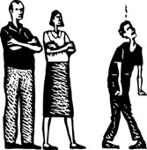
Keys to God’s Kingdom

Traditionally we speak of two keys to God’s Kingdom
the key of the Word
the key of Discipline

Slide 6
Tonight we look at
the key of the Word
How then will they call on him in whom they have not believed? And how are they to believe in him of whom they have never heard? And how are they to hear without someone preaching? Romans 10:14

Slide 7

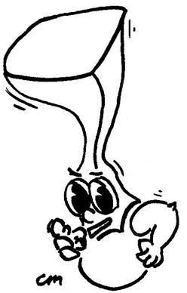
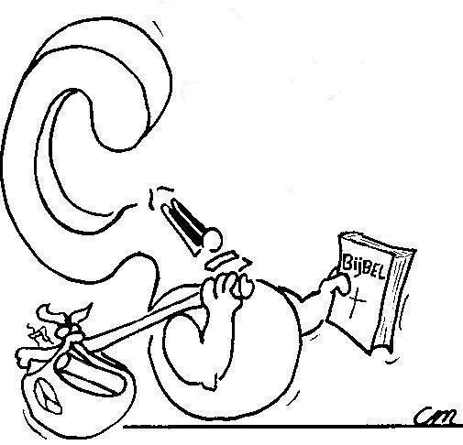
Preaching is telling people on behalf of God where things are at.
What is preaching?

Slide 8
Preaching is

Telling people
On behalf of God
Where things are at.
That message is, in brief:
- This world is God’s world and we are to serve God
- Those who don’t serve God will suffer God’s anger
- Those who do serve God will be saved from God’s anger
- In Christ, God gives us the means to salvation

Slide 9
God’s Kingdom today
God’s Kingdom is:
- God as King, Christ as prime minister and general
- creation as territory
- all people as residents
But there is civil war!
- some people are rebels
- some regions refuse to acknowledge God
- the devil is the rival king
By the preaching God conquers hearts and territory

Slide 10
Entry to the Kingdom
God’s goal is a Kingdom where everyone serves Him
Entry to that Kingdom is ensured by willingness to service (made possible by Christ)
Exclusion from that Kingdom is ensured by refusal to service (living in sin)
The Church is a foreshadowing of the Kingdom
  - It proclaims the gospel of the coming Kingdom
  - It is the group of people, to the extent that man can tell, that will populate the coming Kingdom

Slide 11
Election and Covenant

Only God knows who will ultimately be part of His Kingdom. This is the realm of God’s election.
The LORD brings whom He has elected (chosen) into His Kingdom via a covenant with people.
Election cannot be revoked, it is a unilateral (one-sided) act of God.
The covenant can be broken, it is a bilateral (two-sided) act of God and humans.
  - God initiates the covenant, it is a covenant of grace.
  - God does not break the covenant, not ever
  - Humans can break the covenant (e.g. Esau)

Slide 12

At this moment the Kingdom of God is found in the Church (covenant community).
A duty of the church is, as far as it is able to judge, to point out the elect within the covenant, and to consist of the elect only
All people
Covenant (Church)
Elect (Kingdom)

Slide 13
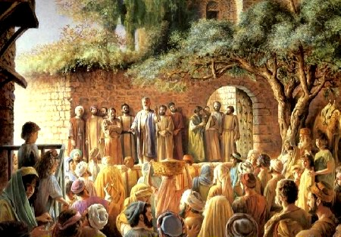
Bible Study: 2 Cor 5:18-21

Slide 14
Bible Study: 2 Cor 5:18-21
1. The ministry of reconciliation
2. Christ
3. Not counting men’s trespasses against them
4. Christ’s ambassadors
5. God
6. We ought to sit up and listen closely!
7. B. Seek the forgiveness of God!

Slide 15
Heidelberg Catechism
According to the command of Christ,
the kingdom of heaven is opened
when it is proclaimed and publicly testified
to each and every believer
that God has really forgiven all their sins
for the sake of Christ’s merits,
as often as they by true faith accept the promise of the gospel.
The kingdom of heaven is closed
when it is proclaimed and testified
to all unbelievers and hypocrites
that the wrath of God and eternal condemnation rest on them
as long as they do not repent.

Slide 16
Heidelberg Catechism
According to the command of Christ,
the kingdom of heaven is opened
when it is proclaimed and publicly testified
to each and every believer
that God has really forgiven all their sins
for the sake of Christ’s merits,
as often as they by true faith accept the promise of the gospel.
The kingdom of heaven is closed
when it is proclaimed and testified
to all unbelievers and hypocrites
that the wrath of God and eternal condemnation rest on them
as long as they do not repent.

Slide 17
Heidelberg Catechism
According to the command of Christ,
the kingdom of heaven is opened
when it is proclaimed and publicly testified
to each and every believer
that God has really forgiven all their sins
for the sake of Christ’s merits,
as often as they by true faith accept the promise of the gospel.
The kingdom of heaven is closed
when it is proclaimed and testified
to all unbelievers and hypocrites
that the wrath of God and eternal condemnation rest on them
as long as they do not repent.

Slide 18
Heidelberg Catechism
According to the command of Christ,
the kingdom of heaven is opened
when it is proclaimed and publicly testified
to each and every believer
that God has really forgiven all their sins
for the sake of Christ’s merits,
as often as they by true faith accept the promise of the gospel.
The kingdom of heaven is closed
when it is proclaimed and testified
to all unbelievers and hypocrites
that the wrath of God and eternal condemnation rest on them
as long as they do not repent.

Slide 19
Heidelberg Catechism
According to the command of Christ,
the kingdom of heaven is opened
when it is proclaimed and publicly testified
to each and every believer
that God has really forgiven all their sins
for the sake of Christ’s merits,
as often as they by true faith accept the promise of the gospel.
The kingdom of heaven is closed
when it is proclaimed and testified
to all unbelievers and hypocrites
that the wrath of God and eternal condemnation rest
on them
as long as they do not repent.

Slide 20
Heidelberg Catechism
According to the command of Christ,
the kingdom of heaven is opened
when it is proclaimed and publicly testified
to each and every believer
that God has really forgiven all their sins
for the sake of Christ’s merits,
as often as they by true faith accept the promise of
the gospel.
The kingdom of heaven is closed
when it is proclaimed and testified
to all unbelievers and hypocrites
that the wrath of God and eternal condemnation rest on them
as long as they do not repent.

Slide 21
What do you remember?
Write down what you remember of last
Sunday's morning sermon.
Do you recall
- hearing the promise of the gospel?
- being warned about God’s anger?
How? Write it down.
Then follows class discussion

