Slide 1
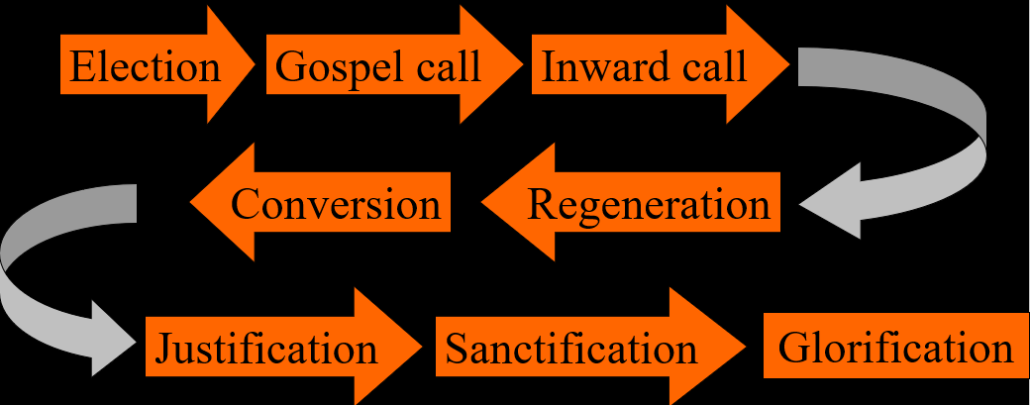
The Order of Salvation
The Gospel Call (aka “preaching”)
Lesson 05

Slide 2
Hymn 81:1,2,5,6
1. O for a thousand tongues to sing
my great Redeemer’s praise,
the glories of my God and King,
the triumphs of his grace!
2. My gracious Master and my God,
assist me to proclaim,
to spread through all the earth abroad,
the honours of your name.

Slide 3
Hymn 81:1,2,5,6
5. He speaks, and, listening to his voice,
new life the dead receive;
the mournful broken hearts rejoice;
the humble poor believe.
6. Hear him, you deaf; you voiceless ones,
your loosened tongues employ;
you blind, behold your Saviour come;
and leap, you lame, for joy!

Slide 4


The chain of salvation
Election
Gospel call
Inward call
Conversion
Regeneration
Justification
Sanctification
Glorification

Slide 5
Gospel call

If God chooses someone unto eternal life, God will have to get them to travel the road to eternal life.
The first thing God does, is have the gospel of salvation preached to them.
Gospel is from Old English “good spell” = good tidings
The Greek is “eu angelia”; the origin of words like evangelism, evangelist, evangelization
And those whom He predestined He also called;...
Romans 8:30a

Slide 6

Bible Study: Romans 10:13-15
1. Everyone who calls on the name of the Lord
2. Believe
3. Hear
4. Preach
5. Send
Inter-mediary
God
Elect believer
Send
Preach
Hear
Believe
Call on God
God
minister
ME!

Slide 7


Why bother?
Why do evangelism (preach the gospel) if God has predetermined who will be saved and will Himself make sure they will be saved?

Slide 8
Why bother?
Why do evangelism (preach the gospel) if God has predetermined who will be saved and will Himself make sure they will be saved?
Because it pleases God to use the service of man to do this. He saves people by having humans preach the gospel to them.

Slide 9
Why bother?
If a framer has decided to nail two pieces of lumber together, he’ll still need to grab a hammer and a nail.
A decision has to be executed. The execution of a decision involves instruments (hammer, nail)
Joined lumber
Framer
Hammer
Nail
Believing person
God
Preacher
Gospel

Slide 10
Why bother?
Which also means, if we don’t preach the gospel, we’re actually preventing God from achieving His purpose!
No hammer – no joined lumber.
No preacher – no believing persons!
How are they to believe in Him of whom they have never heard? And how are they to hear without someone preaching?
Romans 10:14

Slide 11
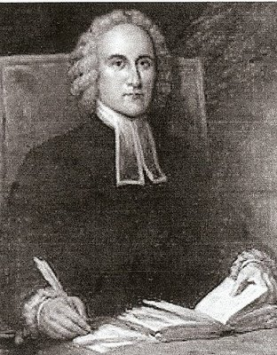
Forgiveness and Damnation
How should a minister, preaching a sermon, speak about forgiveness and damnation in relation to his audience, consisting of both church members and guests?
Therefore, let every one that is out of Christ, now awake and flee from the wrath to come. The wrath of Almighty God is now undoubtedly hanging over a great part of this congregation.
Jonathan Edwards,
from “Sinners in the hands of an angry God”

Slide 12

Comparisons
The gospel can be proclaimed in various ways.
- over the radio / pod-cast
- in a conversation
- during a Bible study
- when the Bible is read
- in a worship service (by ministers, elders, students)
- during instruction (catechism)
What are differences between these?

Slide 13
Does God mean it?
The gospel is: God forgives because of Christ!
However, only the elect receive forgiveness
But more than just the elect hear the gospel
So does God mean what He has preachers say?
How should a preacher say it?
(This tends to be the issue that separates Canadian Reformed, United Reformed, Free Reformed and Heritage Reformed here in North America)

Slide 14
Does God mean it?
How should a preacher say it?
Declaration: You have been forgiven
Conditional: You are forgiven if you believe
Question: Do you believe you are forgiven?
Generalized: Those who believe are forgiven
Command: Seek God’s forgiveness!

Slide 15
Does God mean it?
Yes, God means it.
A preacher should always preach the full counsel of God.
This means assurance of forgiveness to those who are God’s, as evidenced by faith.
This means condemnation to those who refuse to believe.
Ministers are to publicly declare and testify to each believer and to all unbelievers and hypocrites (LD 31)

