Slide 1
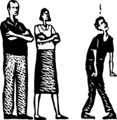
Growing in Faith: LD 25-31
The Keys of the Kingdom
Lesson 07 – LD 31b

Slide 2
Psalm 81:7,8
7. “In the worst of plights 8. “O my people, hear!
comfort I provided. Let my warnings reach you.
On Mount Sinai’s heights My commands revere!
I gave you my law. Would you but obey,
You at Meribah not to evil stray.
tested were and guided.” Listen as I teach you.”

Slide 3



Keys to God’s Kingdom
Traditionally we speak of two keys to God’s Kingdom
the key of the Word
the key of Discipline

Slide 4
Tonight we look at
the key of Discipline
If your brother sins against you, go, show him his fault.
… If he refuses to listen, tell it to the church.
Matthew 18:15a, 17a

Slide 5




Our focus thus is:

Slide 6

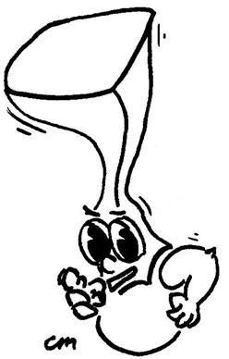
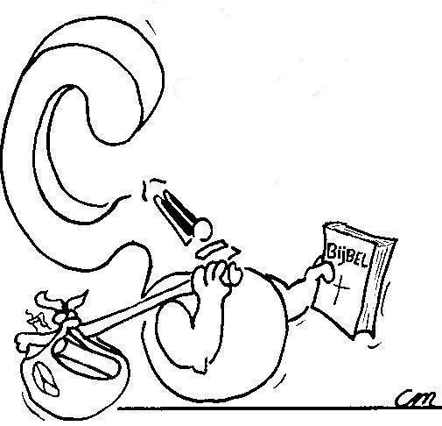
Discipline is telling individuals on behalf of God where things are at.
What is discipline?

Slide 7
Discipline is

Telling individuals
On behalf of God
Where things are at.
Preaching is
Telling people
On behalf of God
Where things are at.

Slide 8
Discipline is

Telling individuals
On behalf of God
Where things are at.
That message is, in brief:
- You are doing something God is not pleased with
- If you don’t change your ways, God will expel you from His Kingdom
- If you do change your ways, God will forgive your sin

Slide 9
Bible Study: Matthew 18:15-18

Slide 10
Bible Study: Matthew 18:15-18
1. Just you and the sinner
2. Visit with others
3. Tell it to the church
4. As a Gentile or tax collector
The person is an object for evangelisation (think of how Jesus treated Zaccheus)
5. Will have been bound / will have been loosed
The church on earth does not have the initiative (heaven does what the church does) but follows (the church does what heaven has done)

Slide 11
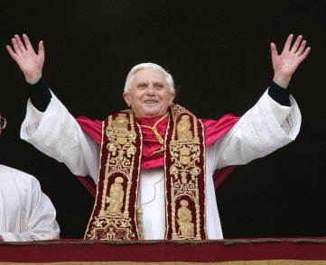

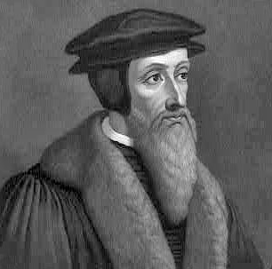
A debated issue

The Roman Catholic Church believes the keys were given to the person of Peter.
Hence, today they are in the hands of his successor, the pope (papa, father).
The pope can personally ban people from God’s Kingdom
The Reformed said, no. The keys were given to Peter as representative of the church. Hence the keys belong with the church, in particular the elders.

Slide 12
Heidelberg Catechism
According to the command of Christ,
people who call themselves Christians
but show themselves to be un-christian in doctrine or life
are first repeatedly admonished in a brotherly manner.
If they do not give up their errors or wickedness,
they are reported to the church, that is, to the elders.
If they do not heed also their admonitions,
they are forbidden the use of the sacraments,
and they are excluded by the elders
from the Christian congregation,
and by God Himself from the kingdom of Christ.
They are again received
as members of Christ and of the church
when they promise and show real amendment.

Slide 13
Exercise
Alone, in pairs or groups of 3 create a flow chart of the process of discipline.
To do this, make use of:
Heidelberg Catechism q&a 85 (pp. 544-545)
Church Order articles 66-68 (p. 639)
Form for excommunication (pp. 599-601)
(The right flow chart will be on the back of your homework sheet.)

Slide 14
The way of Matthew 18
A br or sr sins
Repentance?
Repentance?

Slide 15
The way of Matthew 18
A br or sr sins
Tell the sinner his fault
just the two of you
Repentance?
Tell the sinner his fault, take witnesses
Repentance?
A sinner has been saved!
Report the matter to the church (elders)

Slide 16
Tell the church
A br or sr sins
2 elders tell the sinner his fault
Repentance?
Suspension from Lord’s Supper
Repentance?
A sinner has been saved!
Excommunication process starts

Slide 17
Expelled
A br or sr sins
1st announcement
Repentance?
Classis approval
2nd announcement
Repentance?
3rd announcement
Repentance?
A sinner has been saved!
Excommunication

Slide 18
Withdrawal
At any point during the process, a sinner may decide to withdraw from the church. This implies the person stops being a member. This also implies the responsibility of the church is ended, and the process ‘grinds to a halt’.
Should such a person ever want to come back (repentance!) the person is re-admitted.

Slide 19
Readmission
Repentance!
2 elders visit
Announcement of readmission
At least 2 Sundays
Readmission

Slide 20
Readmission
Repentance!
A sinner has been saved!

