Slide 1
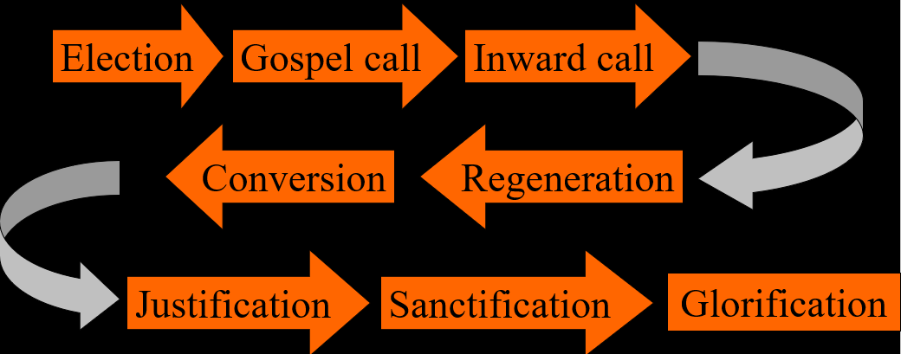
The Order of Salvation
Inward Call
Lesson 7

Slide 2
Psalm 25:2,8
Show your paths to me, your servant,
and direct me in your ways.
Lead me in your truth and teach me;
guide and keep me all my days.
Lord, I know your word is true,
and with eager expectation
all day long I hope in you
as the God of my salvation.

Slide 3
Psalm 25:2,8
Turn to me and show your favour;
I am lonely and distressed.
From my troubles me deliver;
save me, for I am oppressed.
Lord, I plead for your support
as I pine away and languish.
Heal the sorrows of my heart
and relieve my growing anguish.

Slide 4

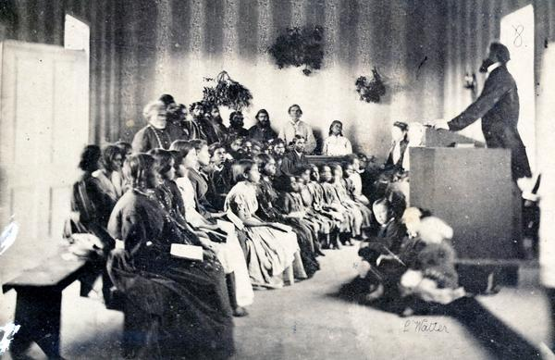
Canons of Dort III/IV.3-8

Slide 5
Canons of Dort III/IV.3-8
1. d. Man is both unwilling and unable to return to God from his fallen state.
2. Man wholly pollutes it and suppresses it
3. It reveals the greatness of sin and more and more convicts man of his guilt
4. It neither points out a remedy nor gives him power to rise out of misery
5. The gospel of the Messiah
6. Because of the sovereign and good pleasure of God
7. Yes (God’s call is earnest)

Slide 6



The chain of salvation
Election
Gospel call
Inward call
Conversion
Regeneration
Justification
Sanctification
Glorification

Slide 7



Outward and Inward call
The outward call is the call that comes to a person from without, and enters his person via the body (senses, in particular the ears)
The inward call is the call that comes to a person from within, and enters his person via the Spirit (emotions, will, the heart)
Maybe think of “falling in love” with someone.
- “outward call” = advances
- “inward call” = butterflies in your stomach

Slide 8

Bible Study: Romans 9:10-21
1. Already before they were born
2. In order that God’s purpose of election might continue
3. By no means
4. Man’s will or exertion
5. On God who has mercy
6. God has mercy on whom He wants to have mercy and He hardens whom He wants to harden
7. Who is man to talk back to God?
8. ….

Slide 9
Inward call
Basically, the inward call is
a heartfelt desire to serve God

Slide 10
Mysterious
The outward call is quite clear to us
  - there is a message
  - there is a tangible (touchable) messenger: preacher
The inward call has many mysterious aspects to it
  - there is an emotion
  - there is a mysterious messenger: the Holy Spirit

Slide 11
Outward and Inward
Not all who hear the outward call, also hear the inward call.
Those who reject the outward call (and thus sin against the Holy Spirit), never have an inward call.
God Himself determines who will inwardly be moved.
God will both outwardly and inwardly call all those whom He has elected.

Slide 12
Outward and Inward
The outward and inward call are not chronological.
What is the order with Lydia? (Acts 16:13-15)
First the inward (she was a worshiper of God)
Then the outward call (she hears Paul preach)
What is the order with the jailer? (Acts 16:29-34)
First the outward (the testimony of Paul)
Then the inward call (what must I do to be saved)
(Or is it more like simultaneously?)

Slide 13
God narrows it down
Of all people,
  many, but not all, hear the Gospel
Of those who hear the Gospel
  many, but not all, are inwardly called
all people
outwardly called
inwardly called

Slide 14
Covenant and Election
Election is God’s decree on who will be saved
Covenant is God’s instrument to bring people to salvation.
The covenant circle is broader than the circle of the elect.
all people
God’s covenant
God’s elect

Slide 15
Subjectivism and Objectivism

In some Reformed circles the inward call is downplayed for fear of subjectivism.
The concern is that, as the inward call can never be verified by others, anyone can claim to be saved.
In other Reformed circles the inward call is emphasized for fear of objectivism.
The concern is that, as sin and God’s judgment must be taken seriously, people will too quickly assume they are saved.
Notes:
Discuss the implications for this as to how one experiences the relationship with God.

Slide 16

Preaching
Covenantal preaching is the type of preaching that explicitly emphasizes the certainty of God’s promise (outward call). It runs the danger of objectivism.
Experiential preaching is the type of preaching that explicitly emphasizes the need for the working of the Spirit (inward call). It runs the danger of subjectivism.
Discuss the pro’s and con’s of objectivism and subjectivism. How might the negative sides to these be addressed in the preaching?
Can a sermon be both covenantal and experiential at the same time?

